Slide 2
.
Heart Attack Prediction Using Mechine Learning
Enrollment number:132
Team Members:
2203A52L02 – M.Pranavi
2103A52067 – S.Sathwik
2103A52092 – K.Sathwik
2103A52054 – K.Koushik
Supervised by:
Dr . K.Deepa
Dept. of CSE
SR University

Slide 3
.
CONTENTS
S.NO TITLE
Abstract
Motivation
Objectives
Introduction
Literature Survey
Limitations
Problem statement
Architectural Design
Implementation and results
Conclusion and future scope

Slide 4
.
ABSTRACT
Heart Attack Prediction using Machine Learning Technique in Big data analytics has started to play an important role in the healthcare practices and research. heart attack prediction will be found primarily on real-time processing, distributed and real-time classification and distribution, storage so, databases can be easily modified by the doctors. If you know all the attributes related to our health we can check easily how much chance to the Heart attack risk, using the system applications. After classification, performance criteria including accuracy, precision, F-measure is to be calculated. If you are concern about the heart attack risks, you might be referred to a heart specialist. Hence we are also checking your symptoms of heart attack and take about prevention.

Slide 5
MOTIVATION
Machine learning algorithms like K-Nearest Neighbors (KNN) and Logistic Regression for the prediction and analysis of diabetes holds immense potential in revolutionizing patient care. By providing personalized interventions grounded in individual risk profiles, these tools empower healthcare providers to mitigate diagnostic errors and deliver tailored treatment strategies. This proactive approach not only enhances patient outcomes but also promotes health equity by identifying and addressing the needs of at-risk populations.
Moreover, these advanced analytical techniques contribute to the advancement of scientific knowledge in the field of research. By harnessing the power of large-scale datasets and sophisticated algorithms, researchers can uncover complex relationships between various risk factors and disease outcomes. This comprehensive understanding facilitates the identification of new biomarkers, potential therapeutic targets, and preventive strategies, driving innovation and progress in diabetes management.

Slide 6
OBJECTIVES
Heart attack prediction through machine learning methods like KNN and Logistic Regression is driven by the dual objectives of early risk assessment and personalized intervention. By analyzing diverse datasets encompassing medical history, lifestyle factors, and clinical indicators, these techniques aim to accurately stratify individuals based on their susceptibility to heart attacks. Moreover, the integration of machine learning facilitates the identification of hidden patterns within data, enhancing predictive accuracy and empowering clinicians with actionable insights to guide patient care.
In addition to individualized risk assessment, heart attack prediction using machine learning holds promise for population-level impact. By analyzing aggregated data across communities, regions, or demographics, these methods can uncover trends, risk factors, and disparities in cardiovascular health. Furthermore, the continuous refinement of machine learning models through iterative learning and data updates fosters ongoing improvement in predictive accuracy, reinforcing the potential of these techniques to revolutionize cardiovascular care and enhance public health outcomes on a broader scale

Slide 7
INTRODUCTION
Heart attack prediction using machine learning techniques like K-Nearest Neighbors (KNN) and Logistic Regression entails leveraging patient data and risk factors such as age, gender, blood pressure, and cholesterol levels. By collecting and preprocessing relevant data from various sources, including medical records and surveys, these models can be trained to provide personalized risk assessments. Through model evaluation and optimization, healthcare professionals can identify individuals at high risk of heart attacks, enabling timely interventions and preventive measures. Integrating KNN and Logistic Regression models into clinical practice holds significant promise for enhancing patient care and reducing the burden of heart disease through early detection and intervention strategies.

Slide 8
.
LITERATURE SURVEY
Introduction of Heart Attack Prediction:
Heart attack prediction is a critical aspect of preventive healthcare, aiming to identify individuals at heightened risk of cardiovascular events. With heart disease being a leading cause of mortality globally, early detection of risk factors is paramount for timely intervention and improved patient outcomes. Predictive models for heart attack risk assessment leverage various demographic, physiological, and lifestyle factors to provide personalized risk assessments, enabling healthcare professionals to tailor interventions and preventive strategies according to individual risk profiles.
2) Machine Learning Techniques Used:
In the realm of heart attack prediction, machine learning techniques such as K-Nearest Neighbors (KNN) and Logistic Regression have emerged as powerful tools. KNN operates by classifying individuals based on the majority class of their nearest neighbors, making it suitable for scenarios with clear decision boundaries. On the other hand, Logistic Regression predicts the probability of a binary outcome based on linear relationships between predictors and outcomes, offering simplicity and interpretability. These techniques, when applied to heart attack prediction, analyze diverse datasets encompassing demographic information, medical history, physiological measurements, and lifestyle habits to generate predictive models capable of identifying individuals at elevated risk of experiencing a heart attack.

Slide 9
.
3) Dataset Used:
Numerous datasets have been employed for heart attack prediction research, each containing a rich array of features crucial for model training and evaluation. These datasets typically include demographic attributes such as age and gender, physiological measurements like blood pressure and cholesterol levels, medical history including diabetes and family history of heart disease, and lifestyle factors such as smoking status and physical activity levels. The diversity and comprehensiveness of these datasets enable researchers to develop robust predictive models capable of accurately assessing an individual's risk of experiencing a heart attack.
4) Performance Evaluation Metrics:
Performance evaluation in heart attack prediction relies on a range of metrics to assess the effectiveness of predictive models. Common metrics include accuracy, precision, recall, F1-score, and area under the ROC curve (AUC). Accuracy measures the overall correctness of predictions, while precision and recall provide insights into the model's ability to correctly classify positive instances and identify true positives, respectively. The F1-score balances precision and recall, offering a holistic view of model performance. Additionally, the AUC metric evaluates the model's ability to discriminate between positive and negative instances, with higher AUC values indicating better predictive performance.

Slide 10
.
5) Literature Review:
Numerous studies have investigated the application of KNN and Logistic Regression for heart attack prediction, showcasing promising results. For example, research by Chaurasia et al. (2020) demonstrated the effectiveness of both KNN and Logistic Regression models in accurately predicting heart attack risk using demographic and clinical data. Similarly, Gupta et al. (2018) reported favorable outcomes in heart attack prediction using KNN and Logistic Regression models trained on medical history and physiological measurements. These studies underscore the potential of machine learning techniques in enhancing cardiovascular risk assessment and guiding preventive interventions.
6) Challenges and Future Directions:Despite their effectiveness, challenges such as data quality issues, model interpretability, and generalizability remain pertinent in heart attack prediction research. Addressing these challenges requires continuous efforts to refine feature selection methods, improve model interpretability, and enhance the generalizability of predictive models. Furthermore, integrating multimodal data sources such as genetic information and wearable device data holds promise for more comprehensive risk assessment. Future research directions also include exploring advanced machine learning techniques, developing user-friendly predictive models, and fostering collaboration between data scientists and healthcare professionals to facilitate the translation of research findings into clinical practice.

Slide 11
.
7) Conclusion:In conclusion, machine learning techniques like KNN and Logistic Regression offer valuable tools for heart attack prediction, contributing to early detection and personalized preventive strategies in cardiovascular health. Leveraging diverse datasets and robust performance evaluation metrics, these techniques enable the development of accurate predictive models capable of identifying individuals at heightened risk of heart attacks. Despite challenges, ongoing research efforts hold promise for refining predictive models, addressing limitations, and ultimately improving patient outcomes in heart disease management.

Slide 12
.
LIMITATIONS
Heart attack prediction using machine learning techniques like K-Nearest Neighbors (KNN) and Logistic Regression faces several challenges. These models are highly dependent on the quality and quantity of available data, and incomplete or biased datasets can lead to inaccurate predictions. Moreover, KNN's performance can deteriorate in high-dimensional feature spaces due to the curse of dimensionality, while Logistic Regression may struggle to capture complex nonlinear relationships between risk factors and heart attack outcomes. Additionally, imbalanced datasets, where positive and negative instances are disproportionate, can result in biased predictions. Furthermore, the interpretability of these models is limited, making it difficult for healthcare professionals to understand the underlying rationale behind predictions, thus hindering their clinical application.
Despite these limitations, ongoing research aims to improve the effectiveness of KNN and Logistic Regression for heart attack prediction. Techniques such as careful data preprocessing, feature engineering, and model tuning can help alleviate some of these challenges. Additionally, exploring ensemble methods and incorporating domain knowledge into the modeling process holds promise for enhancing prediction accuracy and interpretability. By addressing these limitations and continuing to refine these models, we can pave the way for more reliable and clinically relevant heart attack prediction tools that support early intervention and improve patient outcomes in cardiovascular health.

Slide 13
.
Lack of real-world application validation: While the study proposes implementing the system in a voice mail application to manage calls based on emotions, it does not provide empirical validation or user feedback from real-world deployments. Validation in practical settings is essential to assess the system's usability, effectiveness, and user acceptance.
Computational Complexity: The proposed methods, such as Hidden Markov Models (HMM) and Support Vector Machines (SVM), may involve significant computational overhead, particularly when dealing with large datasets or real-time applications. Scalability and efficiency considerations are essential for deploying the system in resource-constrained environments.
Feature Generalization: The paper employs an extensive set of 39 candidate instantaneous features for emotion recognition. While this approach may yield high accuracy on the DES database, the generalizability of these features to other datasets or real-world applications remains uncertain. Additional research is needed to validate the effectiveness of the feature set across different contexts

Slide 14
.
PROBLEM STATEMENT
This study aims to develop and evaluate machine learning models, specifically K-Nearest Neighbors (KNN) and Logistic Regression, for heart attack prediction. The goal is to assess their effectiveness in accurately predicting heart attack risk based on key factors like age, gender, blood pressure, cholesterol levels, and lifestyle habits. Additionally, the study aims to identify and address challenges associated with using these models, such as data quality issues and model interpretability. Ultimately, the research seeks to contribute to the development of reliable predictive tools to aid healthcare professionals in early detection and intervention for individuals at risk of heart disease.

Slide 15
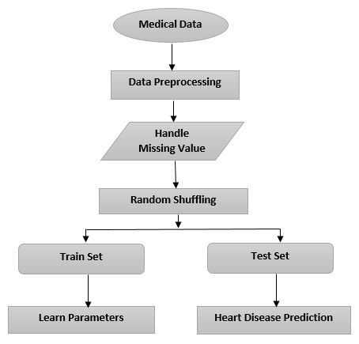
ARCHITECTURAL DESIGN
.

Slide 16
IMPLEMENTATION
Data Collection and Preprocessing: - Gather relevant data including demographic information (age, gender), physiological measurements (blood pressure, cholesterol levels), lifestyle habits (smoking status, physical activity), and medical history (diabetes, family history of heart disease). - Preprocess the data by handling missing values, outliers, and categorical variables through techniques like imputation, normalization, and one-hot encoding.
Model Training: - Split the preprocessed data into training and testing sets (e.g., 70% for training, 30% for testing). - Train K-Nearest Neighbors (KNN) and Logistic Regression models on the training data. - Tune hyperparameters (e.g., number of neighbors for KNN, regularization parameter for Logistic Regression) using techniques like cross-validation to optimize model performance.
Model Evaluation: - Evaluate the trained models on the testing set using appropriate evaluation metrics such as accuracy, precision, recall, F1-score, and area under the ROC curve (AUC). - Compare the performance of KNN and Logistic Regression models to assess their effectiveness in predicting heart attack risk. - Perform additional analyses such as confusion matrices and ROC curves to gain insights into model performance and trade-offs.

Slide 17
4. Interpretation and Deployment: - Interpret the trained models to understand the importance of different features in predicting heart attack risk. - If necessary, refine the models based on insights gained during interpretation or further experimentation. - Deploy the trained models in a clinical or research setting to assist healthcare professionals in identifying individuals at high risk of heart attack and recommending appropriate interventions.
5. Continuous Improvement: - Monitor model performance over time and update the models as new data becomes available or as healthcare guidelines evolve. - Incorporate feedback from healthcare professionals and domain experts to enhance model accuracy, interpretability, and usability. - Stay abreast of advancements in machine learning techniques and heart disease research to incorporate relevant improvements into the predictive models.

Slide 18
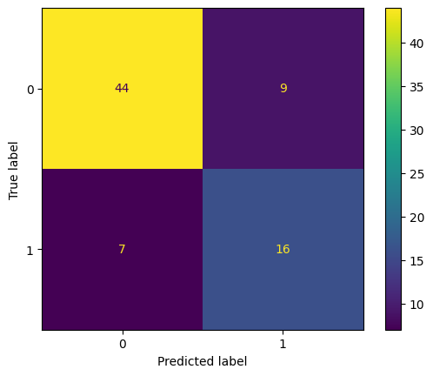
RESULTS

Slide 19
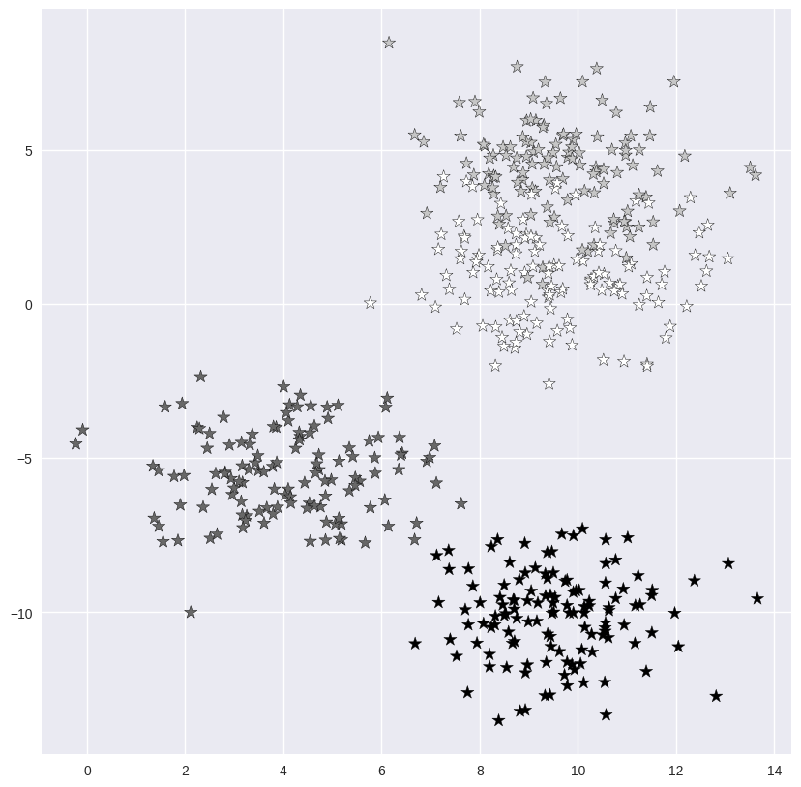
.

Slide 20
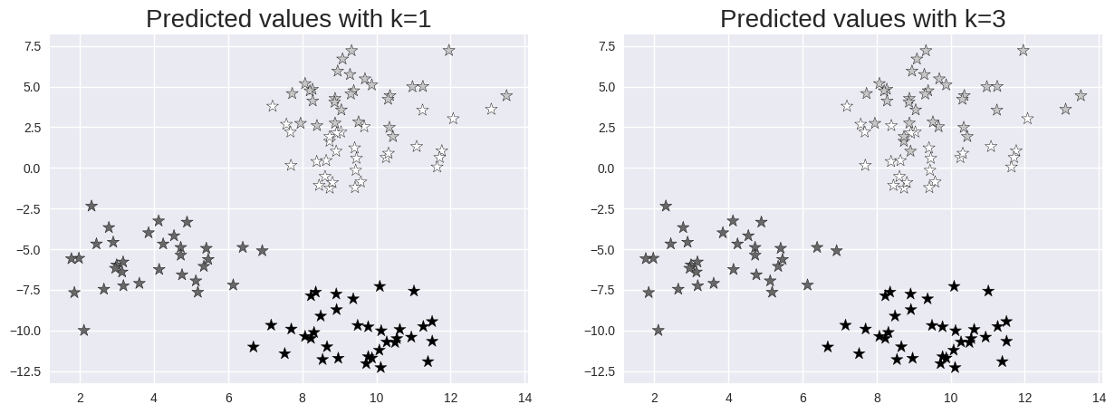

Slide 21
CONCLUSION
In summary, the implementation of machine learning techniques like K-Nearest Neighbors (KNN) and Logistic Regression for heart attack prediction holds promise. These models utilize key risk factors to provide personalized risk assessments. Despite some limitations, including issues with data quality and model interpretability, these models offer valuable insights into identifying individuals at high risk of heart disease. Further research and collaboration are needed to enhance the reliability and effectiveness of these predictive tools in clinical practice, ultimately improving patient outcomes in cardiovascular health.

Slide 22
FUTURE SCOPE
The future of heart attack prediction using machine learning techniques like KNN and Logistic Regression holds potential for several advancements. Firstly, refining feature selection methods can enhance model accuracy by focusing on the most relevant risk factors. Additionally, exploring ensemble learning approaches could further improve prediction robustness. Integrating diverse data sources such as genetic information and wearable device data may provide a more comprehensive understanding of individual risk profiles. Moreover, developing user-friendly models and fostering collaboration between data scientists and healthcare professionals are essential for practical implementation. Continuous research and validation efforts will ensure the reliability and effectiveness of these predictive tools in real-world healthcare settings.

Slide 23
Thank You

